Slide 1
SQL Injection Prevention
By Amanda Munden

Slide 2
Creation of Test Database
The test database is a simplified version of a database that you might find at a school.
It contains three tables:
A table with student information
A table with faculty information
A table with course information
I used WAMP and MyPHPAdmin to be able to see and manipulate the database.

Slide 3
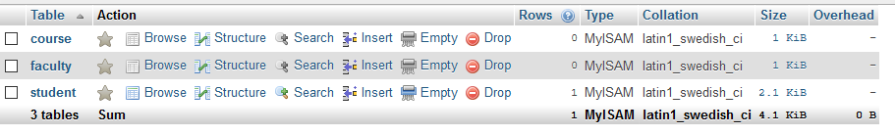
Initial Structure of the Database

Slide 4
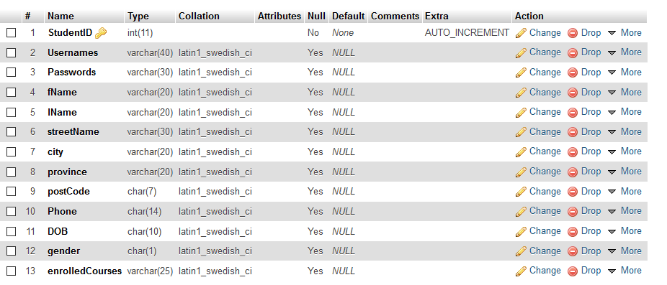
Initial Structure of the Student Table

Slide 5
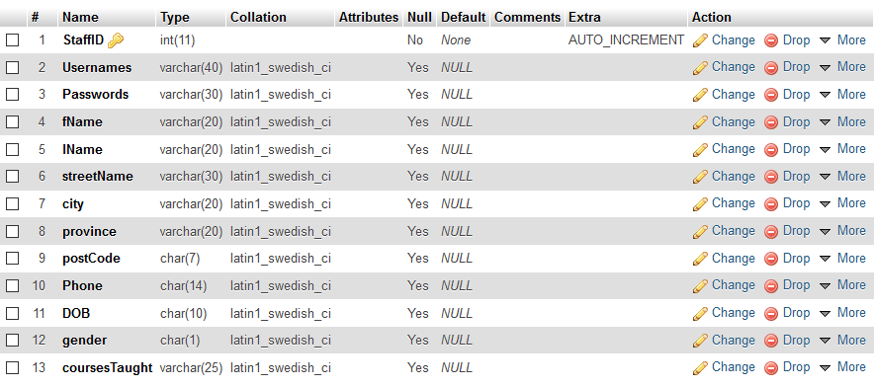
Initial Structure of the Faculty Table

Slide 6
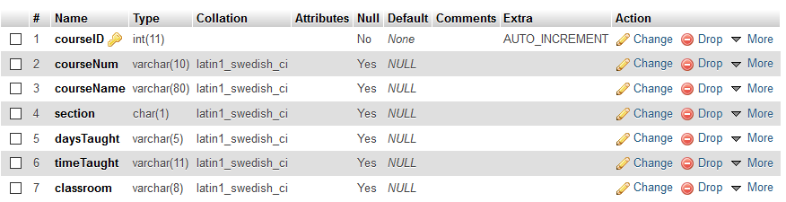
Initial Structure of the Course Table

Slide 7
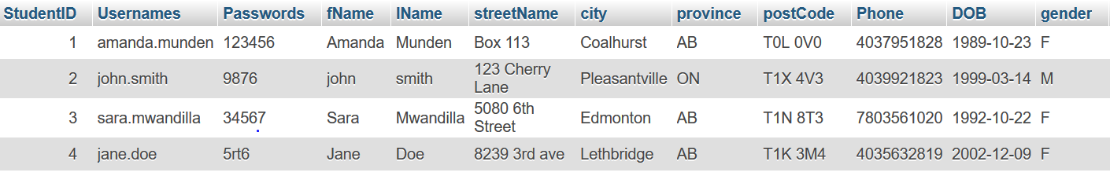
Student Sample Data

Slide 8
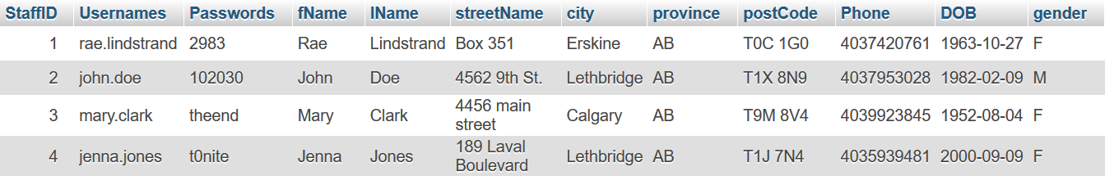
Faculty Sample Data

Slide 9
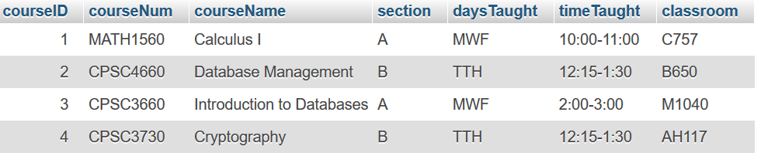
Course Sample Data

Slide 10
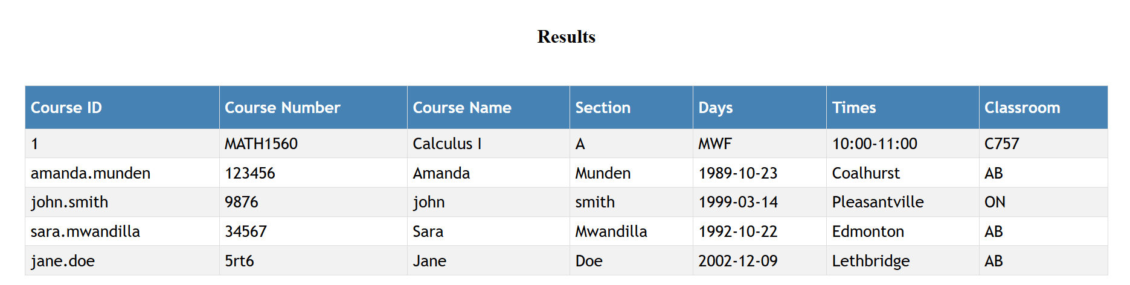
SQL Injections
All initial php files were written to be vulnerable to SQL injections.
Used searchCourse.php to
do a UNION SQL injection
to gain the usernames
and passwords from the
student table.

